Slide 1
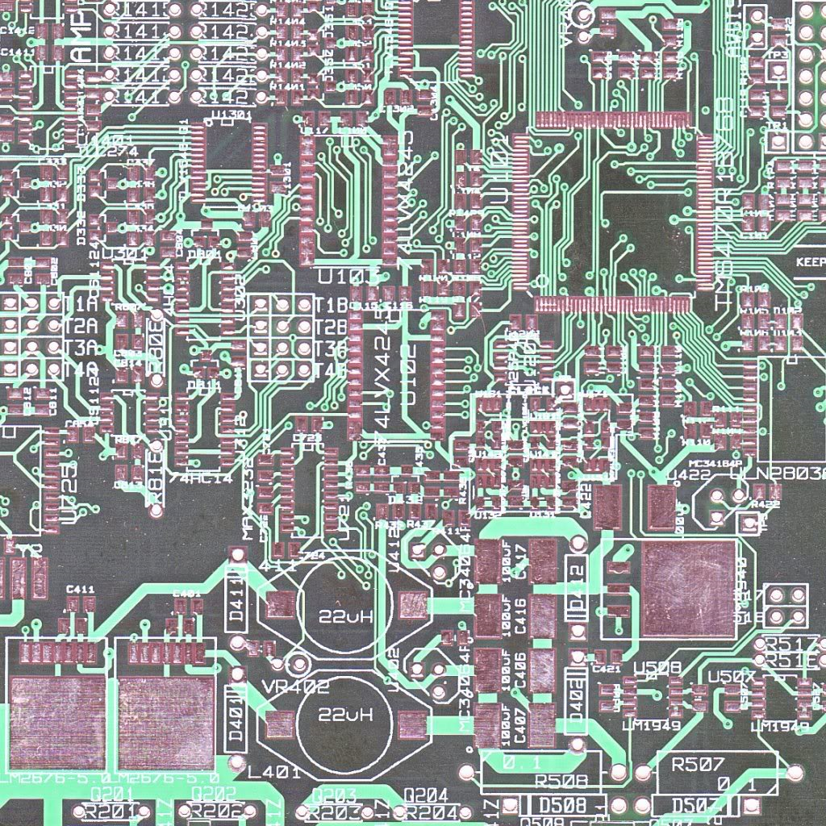
Delaminating and Recycling of
Printed Circuit Boards using Supercritical CO2
School for Engineering of Matter, Transport and Energy
Arizona State University
Mariela Robledo , Chemical Engineering
Mentors: Lenore L. Dai, Terry Alford

Slide 2

Traditional Recycling Processes
Traditional metallurgical processes used for the recycling of printed circuit boards require high energy input, provide limited economic returns, and are environmentally harmful. Recent experimental results show that a supercritical fluid process of CO2 with a small amount of water low/medium temperatures and pressures can delaminate the boards for further recycling.

Slide 3
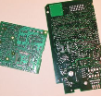
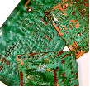
Delaminating using Supercritical Fluids
The objective is to test a new, environmentally benign technology using carbon dioxide in supercritical conditions to delaminate and recycle PCB through supercritical fluid dyeing. By using Azo dyes, the “swelling and foaming” mechanism can be tested to identify how the supercritical fluid (SCF) “dissolves” the polymer.
Figure 1: Original PCB
Figure 2: Delaminated PCBs

Slide 4
Schematic diagram of the supercritical CO2 system

Slide 5
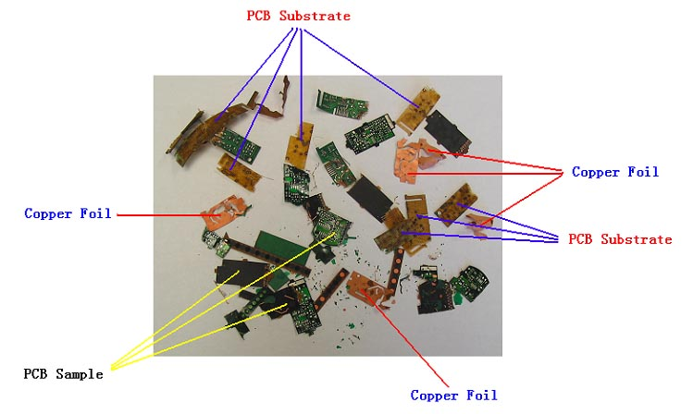
PCB specimen after treatment in pure supercritical CO2

Slide 6

Separated PCB Components
(a) (b) (c)
Figure 5: (a). Glass Fibers, (b). Copper, (c). Powder of polymer components

Slide 7
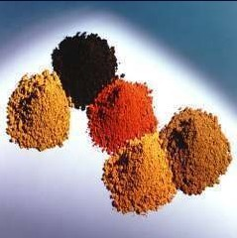
Azo Dyes
Disperse Dye Orange 30
Processing Information:
  Diffusion can occur at temperatures lower than the traditionally required
  After dying with supercritical carbon dioxide, it does not require any further drying or washing.
Processed at temperatures between 313
and 393 K, wavelength: 414.0 nm

Slide 8
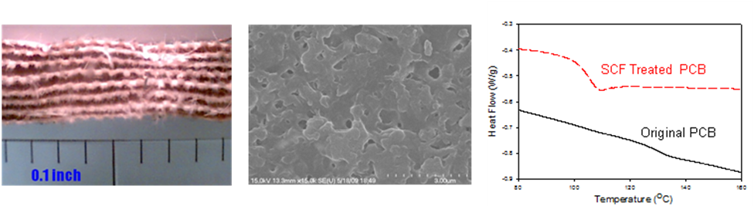
Future Work
Azo dyes will be tested in the supercritical carbon dioxide process to determine the nature of polymer degradation in the recycling of printed circuit boards. Future work includes integrating other processes to this approach to understand the polymer degradation mechanism and identify previous components of contamination threats.
After processing is completed, the boards can be further analyzed to understand the degradation process of polymers.
Figure 7.
Left: microscopic image of a PCB sample under a SCF process
Middle: a SEM image of the same sample
Right: comparison DSC curves of the original and SCF treated samples.

Slide 9
References
Stanford Resources Inc., "Electronic Product Recovery and Recycling Baseline Report: Recycling of Selected Electronic Products in the United States," National Safety Council, Washington, DC, 1999.
S.-O. C. Taberman, B, Erichson, H, Brobech, J., and Gregersen, J.C., "Environmental Consequences of Incineration and Landfilling of Waste from Electr(on)ic Equipment," TemaNord report to the Nordic Council of Ministers,Copenhag., 1995.
H. C. Zhang and Z. Gao, “Printed Circuit Boards Recycling: A State-of Art Survey,” IEEE Transactions on Electronics Packaging Manufacturing, vol. 27, no. 1, pp. 33- 42, 2004.
G. Pitts, Collen Mizuki, "A View of Electronic Products Disposition," Proceedings of the 1996 IEEE International Symposium on Electronics and the Environment, pp. 66-72, 1996.
Smith and Van Ness, Introduction to Chemical Engineering Thermodynamics, Fifth Edition, McGraw-Hill, 1996.

Slide 10


Recognitions
Lenore L. Dai, Principal Investigator
  Chemical Engineering, Department Chair
Terry Alford
  Materials Science & Engineering, Graduate Chair
Sriya Sanyal
  Graduate Mentor
ASU NASA Space Grant
Fulton Undergraduate Research Initiative
School for Engineering of Matter, Transport and Energy;
Arizona State University

